Slide 1
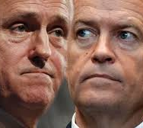

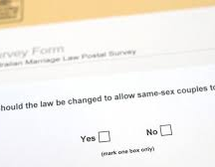
Trend analysis on 2016 Federal Election and 2017 Australian Marriage Law Postal Survey results
Catherine Sloan, Danielle Cahill, Anne Wieggers
Monash University
April 2021

Slide 2
Agenda
Theme and purpose
Coding approach
Data mungling process
Visualisations
Observations

Slide 3
Trend analysis of Federal Election and Marriage Law Postal Survey results
Trend analysis on 2016 Federal Elections results and 2017 Marriage Law Postal Survey results from the Australian electoral divisions in each state
This analysis can provide valuable insights for political parties and campaign organisers for future federal elections and surveys when running their campaigns
The following relationships have been analysed:
Federal Elections results and Marriage Law Postal Survey results
Federal Elections results, Marriage Law Postal Survey results and socio-economic factors (age and education)
socio-economic factors and the way of voting (postal or in person)

Slide 4
Data sources
Australian Electoral Commission: 2016 Federal Election Vote Types by Division
Australian Electoral Commission: 2016 Federal Election Results
Kaggle: Australian Marriage Law Postal Survey Electorate Results
Kaggle: Australian Marriage Law Postal Survey Participant Information
Australian Bureau of Statistics: Commonwealth Electorate Data

Slide 5
Coding approach
Step | What | How
Exploratory data analysis | Summary statistics and visualisations | Pandas, Matplotlib
Extract | Extracting data from source | Web scraping and document downloads
Transform | Make data fit for analysis | Pandas
Load | Create database structure and load data | PostgreSQL, PgAdmin, Pandas
 | Flask app | OS, Pandas, Numpy, SQLAlchemy, Flask, SimpleJson, Javascript, CSS, Leaflet, Chloropleth, Bootstrap, GeoJson, D3
 | Connecting to and reflecting database
 | Creating routes for rendering index.html, tables and visualisations
 | Conversion of results to JSON
 | Create visualisations

Slide 6
Data mungling techniques
Step | What | How
Transformations | Checking datatypes | Pandas
 | Remove NaN values and duplicates
 | Drop irrelevant columns and rename columns
 | Set primary key as index
 | Merge tables (joining on primary key)
 | Perform “group by” functions and aggregates to run calculations
 | Recreate bins so that all age bins used within all tables are consistent

Slide 7
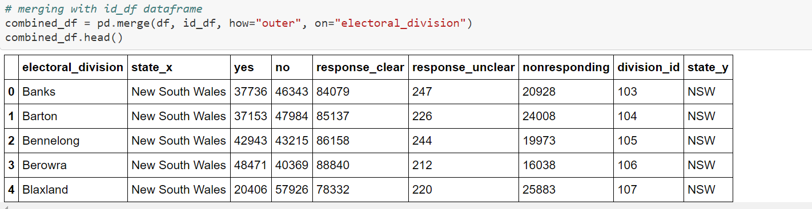
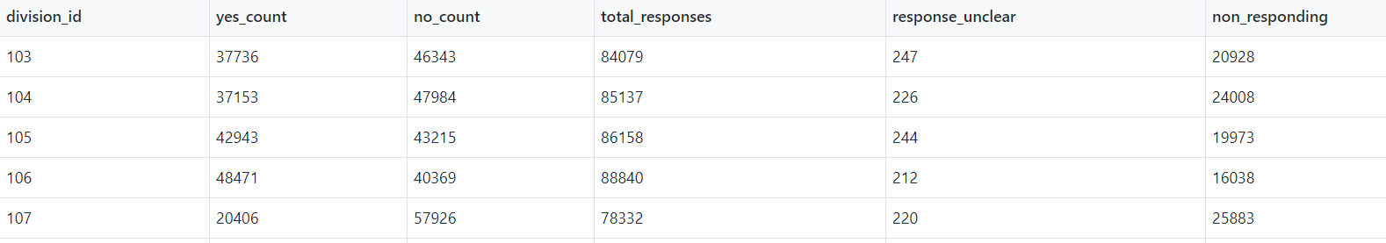
Snapshots data mungling code and raw data
The visualisations below are snapshots of the code and raw data of the Marriage Postal Survey results

Slide 8
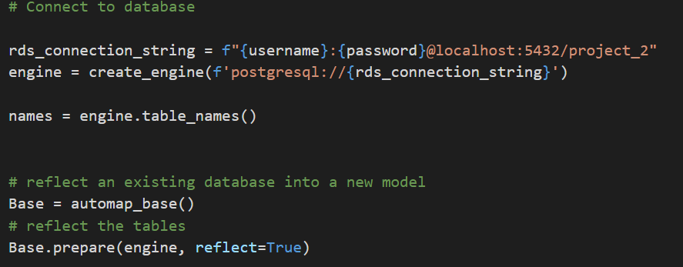
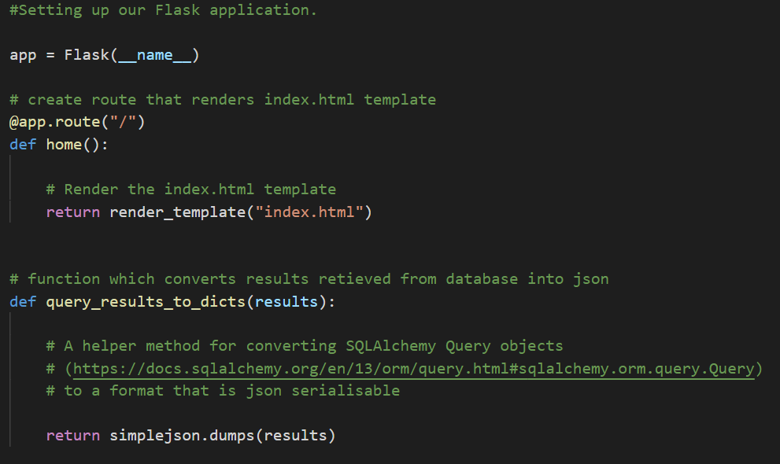
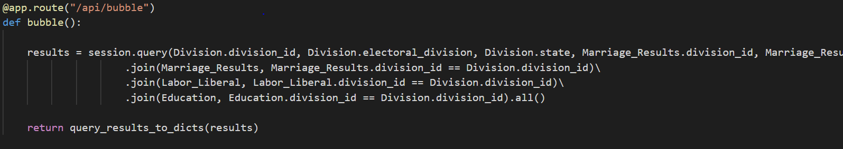
Snapshots code Flask app
The visualisations below are some snapshots of the code to create the Flask app and routes

Slide 9
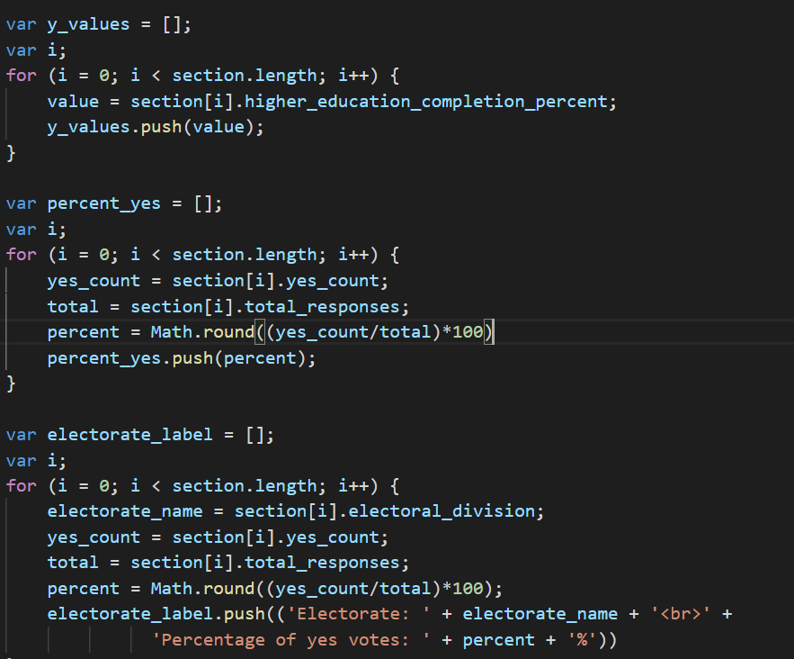
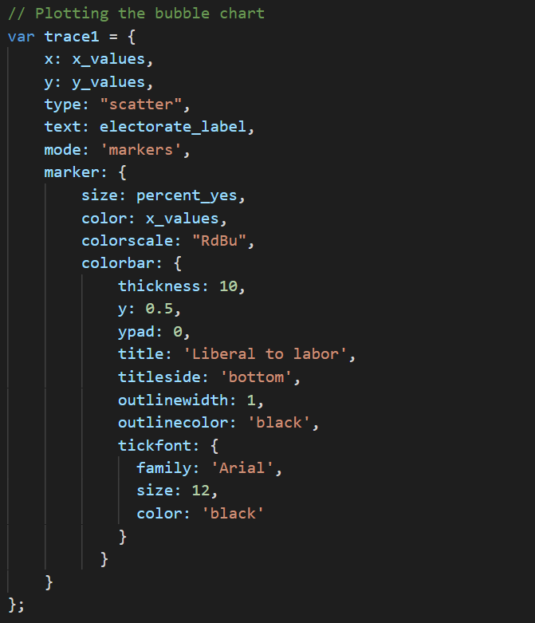
Snapshots code visualisations
The visualisations below are some snapshots of the code written to create charts using Javascript

Slide 10
Visualisations [insert link once final to show interactivity]

Slide 11
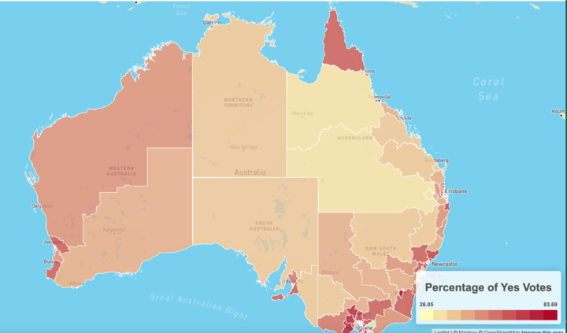
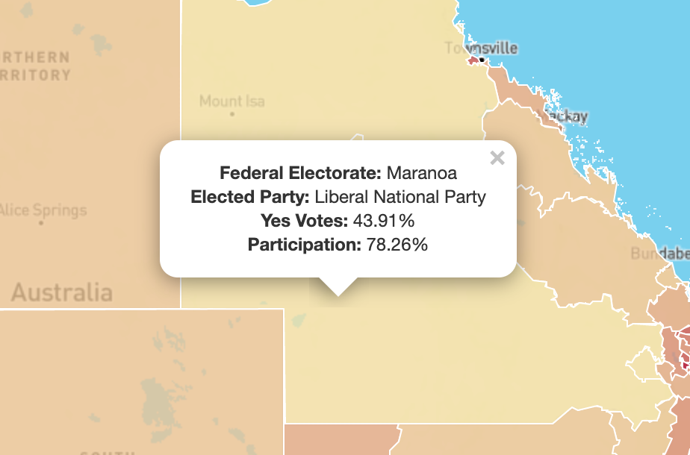
Visualisations [insert once final to show interactivity]

Slide 12
Observations
[insert observations once visualisations are finalised]

Slide 13
Enhancements/challenges
Enhancements | Challenges
No colour was shown for certain electorates in the map as the data did not entirely match up | As the dataset did not contain the coordinates of the electorates, the outlining of each of the electorates had to be created using GeoJSON.
 | Open the app on Australia (and not on state level)

Slide 14
Questions?

